Slide 1
SharePoint Server 2016 搶先看
林順民 Sam Lin
Support Escalation Engineer
Microsoft
Notes:
1
歡迎各位參加這場 SharePoint Server 2016 搶先看 Session, 敝姓林, 目前任職於台灣微軟技術支援部門, 主要負責 SharePoint 技術支援工作, 很榮幸跟各位介紹 SharePoint Server 2016 新功能

Slide 3
Disclosure Statement
Discloses SharePoint futures roadmap and high-level areas of investment
Dates and capabilities are subject to change
Screen captures or concepts are for illustration purposes only
Disclaimer
This presentation contains preliminary information that may be changed substantially prior to final commercial release of the software described herein.
The information contained in this presentation represents the current view of Microsoft Corporation on the issues discussed as of the date of the presentation. Because Microsoft must respond to changing market conditions, it should not be interpreted to be a commitment on the part of Microsoft, and Microsoft cannot guarantee the accuracy of any information presented after the date of the presentation. This presentation is for informational purposes only.
MICROSOFT MAKES NO WARRANTIES, EXPRESSED, IMPLIED, OR STATUTORY, AS TO THE INFORMATION IN THIS PRESENTATION.
Microsoft may have patents, patent applications, trademarks, copyrights, or other intellectual property rights covering subject matter in this presentation. Except as expressly provided in any written license agreement from Microsoft, the furnishing of this information does not give you any license to these patents, trademarks, copyrights, or other intellectual property.
Copyright© 2015 Microsoft Corporation

Slide 4
議程
SharePoint Server 2016 發展藍圖
新功能與改變
安裝部署與升級
常見問題
Notes:
介紹這場的主題

Slide 5


SharePoint 演進
SharePoint
Portal Server 2001
SharePoint
Portal Server 2003
Office SharePoint
Server 2007
SharePoint
Server 2010
SharePoint
Server 2013
SharePoint
Server 2016
2001
2003
2006
2009
2012
2016
Microsoft
Managed Solutions
Microsoft
Online Services
小組與入口網站
內容管理
雲端與企業社群
功能
混合雲
一致的使用者經驗
Notes:
1
SP 發展超過 15 年, SP 2001, 2003 小組入口網站, MOSS 2007 內容管理, SharePoint Online 開始發展, SP 2010, 2013 主推雲端與社群功能, 同時 Office 365 提供完整的雲端服務, 2015 - 2016 年 SharePoint 2016 將會著重於混合雲有一致的使用者經驗

Slide 6
SharePoint Server 2016 時程
Office 365
SharePoint
Server 2013
(Oct 2012)
CU1
CU2
CU3
Service Pack 1 (Feb 2014)
CU5
CU6
…
SharePoint Server 2016 Preview
(Aug 2015)
SharePoint Server 2016 RTM
(Q2 CY2016)
SharePoint 2016 與雲端版本使用統一的 Code Base
新功能將會先在 Office 365 上驗證並釋出
SharePoint Server 2016 會包含大部分新的功能
On-premises SharePoint Server 還是會維持兩到三年一個版本的生命週期
Release | Frequency | Contents
Security Update | As required | Security fixes
Cumulative Update | Quarterly | Bug fixes
Service Pack | Periodically | Bug fixes; minor enhancements
Major Release | Every 2-3 years | New features
Notes:
2
1. SP 16 會和 Office 365 使用統一的 Code Base, 大部分的功能會跟 Office 365 一致, 再加上 On-Prem 才有的功能
2. 新功能會在 Office 365 不同的環境(Dogfood, MSIT)驗證, Release 於 Prod 環境後再釋出到 SP 16, 好處是透過雲端上各種複雜的的使用情境驗證後, 減少問題產生的機會
3. 企業部署混和雲的環境, 雲端也可以存取到 On-Prem 的資料, 可以加速新功能的應用, 不必花設備成本建立環境 (Azure SharePoint 2016 Template, Office 365 Trial)
4. 目前未來 Release 週期仍會維持 On-Prem 2~3 一個版本, 暫時沒改變, 其他 Security - Security fixes, CU update - Bug fixes, Service Pack - Bug fixes 與小改版, Major Release - 新功能大改版仍會如 SP 2013
SharePoint Server 2016 Preview, http://www.microsoft.com/en-us/download/details.aspx?id=48712
Download and install full-featured software for a 180-day trial
When prompted, use the following product key: NQTMW-K63MQ-39G6H-B2CH9-FRDWJ
Slide Objective:
Share product timeline delivery dates and showcase our response to customers’ needs in the changing information worker environment in SharePoint 2016.
Slide Overview/Detailed Notes:
Our target for the release of SharePoint 2016 is calendar year 2016.
SharePoint Server 2016 is the product of a converged SharePoint on-premises and SharePoint Online codebase, which provides three (3) advantages:
Consistent Codebase
Improved build quality and closes parity gap between SharePoint and SharePoint Online.
Cloud Validated
Validated in the cloud means the most comprehensively tested version of SharePoint to date.
Agile Infrastructure
No need to setup or maintain on-premises equipment for new or special projects, since enterprise data can be accessed in the cloud

Slide 7
新功能與改變
基礎架構
效能與可靠度
使用者體驗
現階段 Preview 的過時功能
Notes:
介紹新功能與改變

Slide 8







角色
2016
2013
MinRole
[…..] Distributed Cache and Request Management
User services
sync client
onenote
user profile
page
rendering
Distributed Cache, Request Management, SharePoint Foundation Web Application
excel
services
sandbox
code
project
subscription
settings
[…..] Web Servers
Access Services, Business Data Connectivity, Central Administration, Managed Metadata,
SharePoint Foundation Web Application, Secure Store Service, State, Subscription Settings, User Code,
User Profile, Visio Graphics
Robot services
[…..] Batch Processing
provisioning
timer jobs
search
Crawl Target, Machine Translation, SharePoint Foundation Web Application, PowerPoint Conversion,
User Profile Synchronization, Word Automation, Work Management, Workflow Timer Service
[…..] Specialized Workloads
邏輯上集成相對應的服務到單一主機
降低角色過於分散的架構
Caching services
Excel Calculation, PerformancePoint, Project, Search, SharePoint Foundation Web Application
caching
Notes:
10
2013 以伺服器服務角色作為安裝區分, 例如 Web Front End, Application Server, 服務各運行在各自的主機上, 不同主機根據不同的角色定義有不同的規格需求, 管理者需要自行根據定義將角色設定於主機上, 實際上角色之間可以隨時自行調整與變更,
2016 架構的改變則是將角色定義寫在 Code 裡面, 根據服務的型態, 大致上區分為使用者服務, 自動化服務, 快取服務等, 根據服務的需要, 將預先定義的角色邏輯上集成到單一主機上, 自動安裝相對應的服務到 Local 主機上, 稱為 MinRole,
區隔每個 Request 在單一主機上執行, 減少跨主機存取的相依性與 overhead

Slide 9
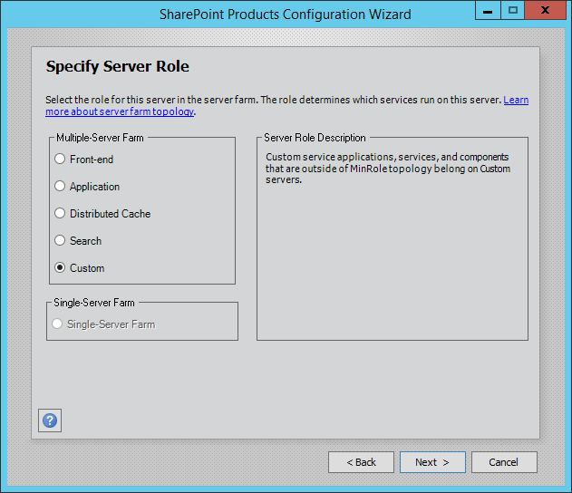
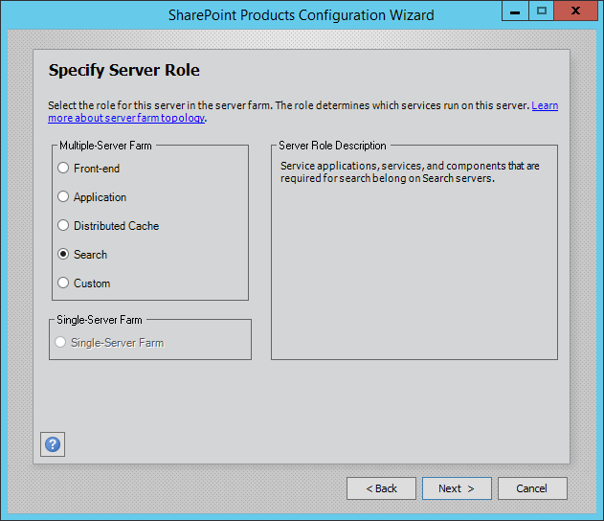
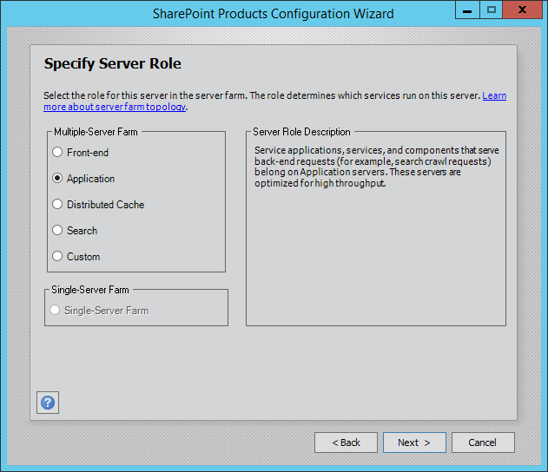
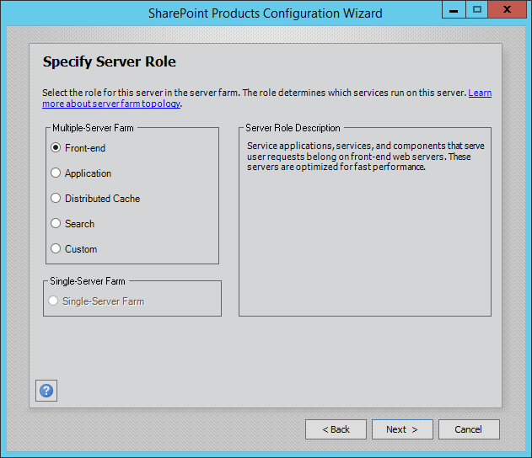
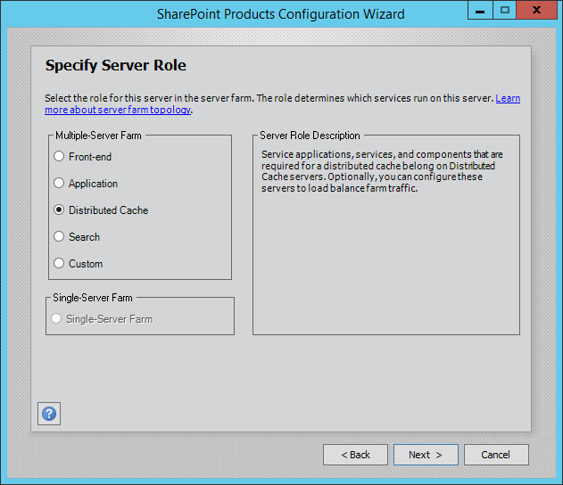
MinRole
Notes:
3
解釋每個 MinRole
WFE - Lowest Request Latency
Application - Back End Request Optimize throughput
Distributed Cache - Distributed Cache traffic load balancing
Search - Specific for search

Slide 10


MinRole Demo
Notes:
10
Configuration Wizard
Walkthrough MinRole in the Server (Servers in Farm, Services in Farm, Services in Server) – Auto provision
Health Analyzer

Slide 11
0 Downtime Patching
移除 CU 重複的 MSPs
SP2013 – 37 MSI/MSP per update + 18 for language packs
SP2016 – 4 MSI/MSP per update + 1 all languages
減少每個 MSP 重啟服務的次數
支援部分元件降級運行
移除 Front End 與 Back End 相依性
線上執行 Upgraders
僅適用於 Full HA farm
Notes:
2
SharePoint 2013 最痛苦的一件事, 就是上 Patch, 如果你的環境有很多主機, 如果更幸運你們的 Farm 有安裝了不同的語言包, 每次上 Patch 的停機時間會花掉你周末的時間…
Office 365 可以提供很高的 SLA, 使用的就是新的 patch 方式, SharePoint Server 2016 採用把這個更新方式
以下的方式達成 Zero Downtime patching
移除 CU 重複的 MSPs
SP2013 – 37 MSI/MSP per update + 18 for language packs
SP2016 – 4 MSI/MSP per update + 1 all languages
減少每個 MSP 重啟服務的次數
支援部分元件降級運行
移除 Front End 與 Back End 相依性
線上執行 Upgraders
適用於 Full HA farm

Slide 12
Project Server
SharePoint Server
PWA
Project Server
WCF Services
Project Server Interface (PSI)
Project Server Queuing System
Local Event Handlers
Project Server Eventing System
Business Objects
Project Calculation Service
Project Server Workflow System
Content (+Project) Database
Project Database
Content Database
Configuration Database
Notes:
Slide Objective:
Going forward, the Project database will live within the SharePoint content database, meaning less for admin. to manage. This database consolidation has already begun for Project Online customers, now is for SharePoint Server 2016
Slide Overview/Detailed Notes:
One area that we constantly think about is lowering the costs that customers incur in managing and maintaining the Project Server environment. Today as you can see there is a Project Data Store that is different from the SharePoint data repositories.
Going forward, we will consolidate the Project database into the SharePoint content database. This will help lower the costs associated with managing multiple databases. This change has already gone into effect for our Project Online customers and will also be available to the Project Server customers in the next release.

Slide 13
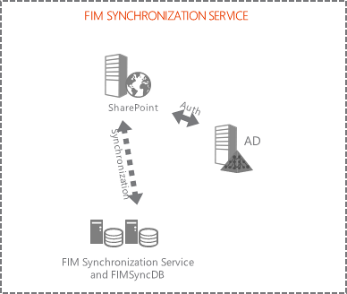
User Profile Service
移除內建 FIM Sync 服務
支援外部 FIM Sync
AD Import
Notes:
1
移除內建 FIM Sync 服務
支援外部 FIM Sync
AD Import 為唯一的 User Import 方式

Slide 14
認證
Windows identity over SAML claims
Normalizes on OAuth and JWT/SAML with WSFED
IdP
Request
3
4
Approved
Important resources
File Servers
OneDrive
5
Here is my proof
2
Email
Wireless
Prove to me who you are
1
Access please
Notes:
在 SharePoint 2013, 我們有 Windows Claims, Form, SAML, WSFed 認證提供者 , 為了提供向下相容, Windows identity over SAML 認證在 SharePoint Server 2016 仍是頭等的 Support, SP 2016 正規化了 Oauth 以及 JWT/SAML with WSFed 認證模式, 認證的改變將從過去 On-Premises Windows AD 驗證的倚賴, 轉向雲端與 Open 的認證模式.

Slide 15
支援 SMTP 連線加密
SMTP Server 支援啟用 STARTTLS
SMTP Server 必須支援 TLS 1.0, 1.1 or 1.2
SMTP Server 必須安裝伺服器憑證
支援非預設 TCP Port 25
如果加密的連線失敗, 不會轉換到未加密的連線
Notes:
除了未加密的 SMTP 設定外, SharePoint Server 2016 支援 SMTP 連線加密
STARTTLS
TLS 1.0.1.1.1.2
Certificate
Non-Default port TCP 25
No fallback to unencrypted SMTP

Slide 16
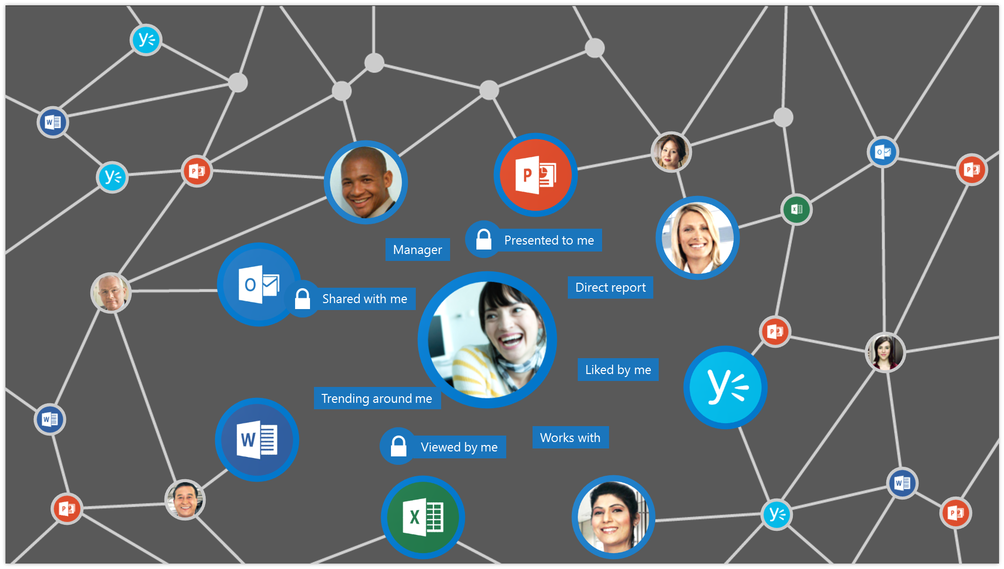

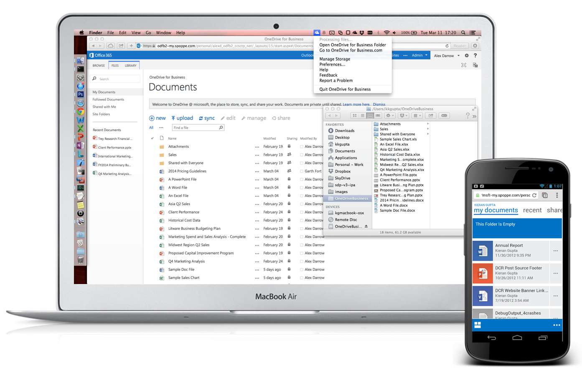
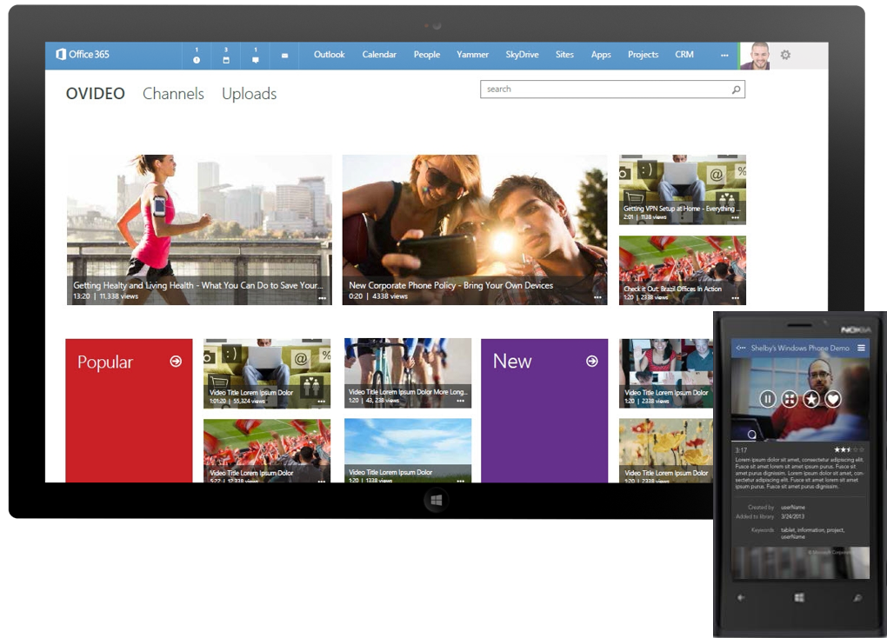
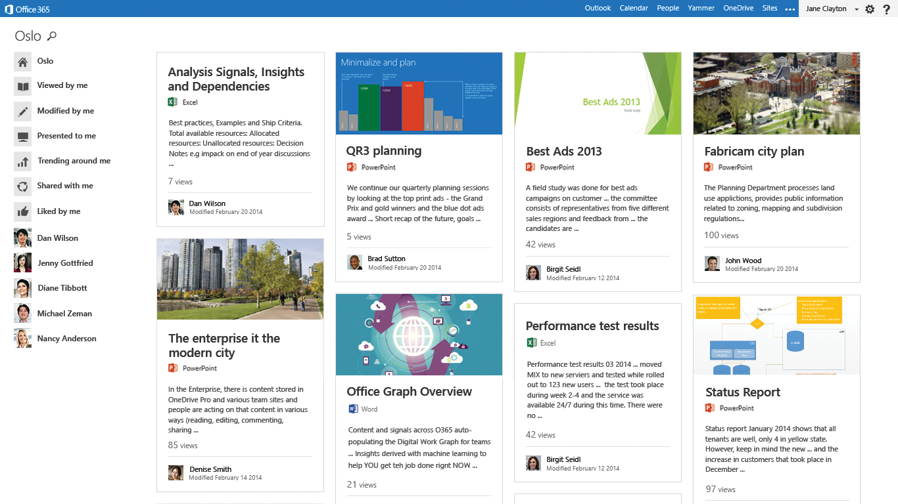
混合雲解決方案
Delve 與 Office Graph 整合
新一代入口網站 Video Portal
OneDrive for Business 及小組網站
Familiar, consistent experience across phone, tablet, and desktop
Stay “in the know” with what your closest colleagues are working on across on-premises and Office 365
Secure cloud based video upload, storage and optimized playback
Collaborate on Office documents in real time with inline social experiences
Create, manage, and subscribe to various channels
Capture, share, and discover videos from any device
Notes:
1
新一代的 Search 服務 – 使用 Office Graph 與 Delve
https://technet.microsoft.com/en-us/library/dn607315(v=office.16).aspx
Plan for hybrid OneDrive for Business
Configure hybrid OneDrive for Business - roadmap
Plan server-to-server authentication
Configure hybrid sites features - roadmap

Slide 17
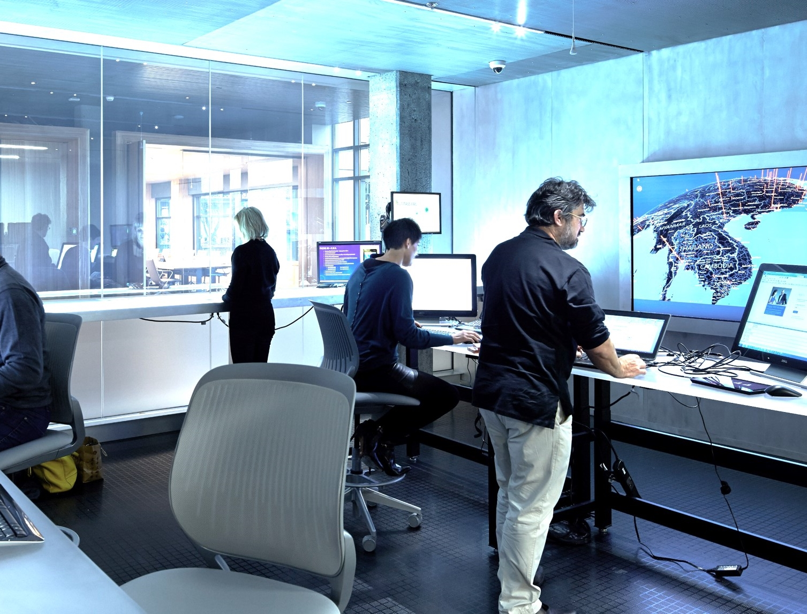
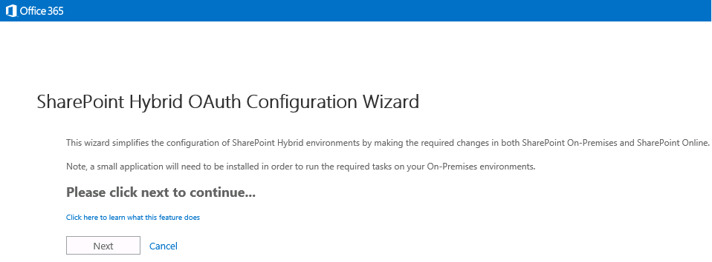
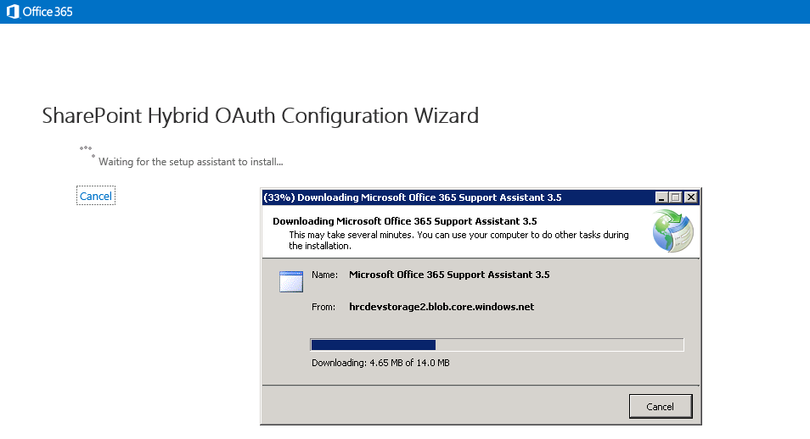
Hybrid Picker
混合雲自動化部署工具
混和雲先決條件檢查
精靈介面
腳本選擇
Hybrid OneDrive for Business
Hybrid Site
Notes:
1
9/17 - OFC211 -如何安全存取混合雲中的OneDrive for Business

Slide 18
混合雲設定精靈 Demo
Notes:
5
1st Release in Office 365 Settings > Updates
Hybrid Picker in SharePoint Admin
https://support.office.com/en-us/article/Hybrid-picker-in-the-SharePoint-Online-admin-center-efce8417-c9bc-4a2c-ac9d-cce6c4e84a9c?ui=en-US&rs=en-US&ad=US

Slide 19
軟體界限及限制
內容資料庫大小
內容資料庫的網站集合數量
清單閥值
檔案限制 大小與字元
索引項目 數量
支援至 TBs 以上
100,000 網站集合
突破 5000 限制
最大支援到 10G
取消部分字元限制
& ~ { } GUID . 開頭, 128 字元長度
(% 和 #限制仍存在)
增加 2 倍至 50 億個項目
Notes:
4
TBs ➔ 還沒定義 (Office 365)
10,000 maximum ➔ 10 倍
5000 限制
&, ~, {, and } characters, file names that contained a GUID, file names with leading dots, and file names longer than 128 characters.

Slide 20
快速建立網站
基於內容資料庫層級的建立網站集合方式 (SPSite.Copy)
實作於主要的網站集合
消除啟用功能的成本
Notes:
2

Slide 21
檔案傳輸效能
BITS Protocol 支援
下載
Byte-range HTTP GETs
上傳
BITS specific block-based upload protocol
Data
Application
Data
Presentation
HOST LAYERS
Data
Session
Segments
Transport
Packets
Network
MEDIA LAYERS
Frames
Data Link
Bits
Physical
Notes:
Byte-range HTTP (續傳)
改用 BITS 背景傳輸 – 利用 Idle 頻寬, 非同步上傳

Slide 22
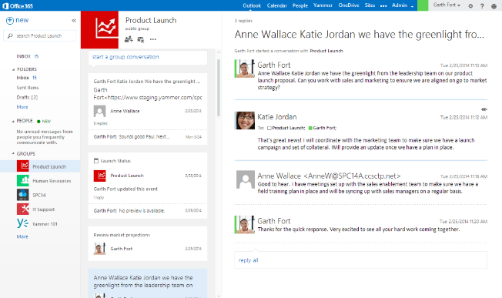
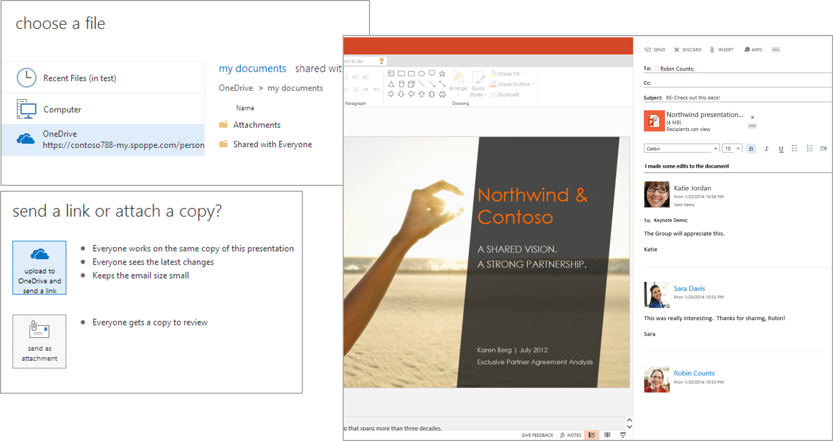
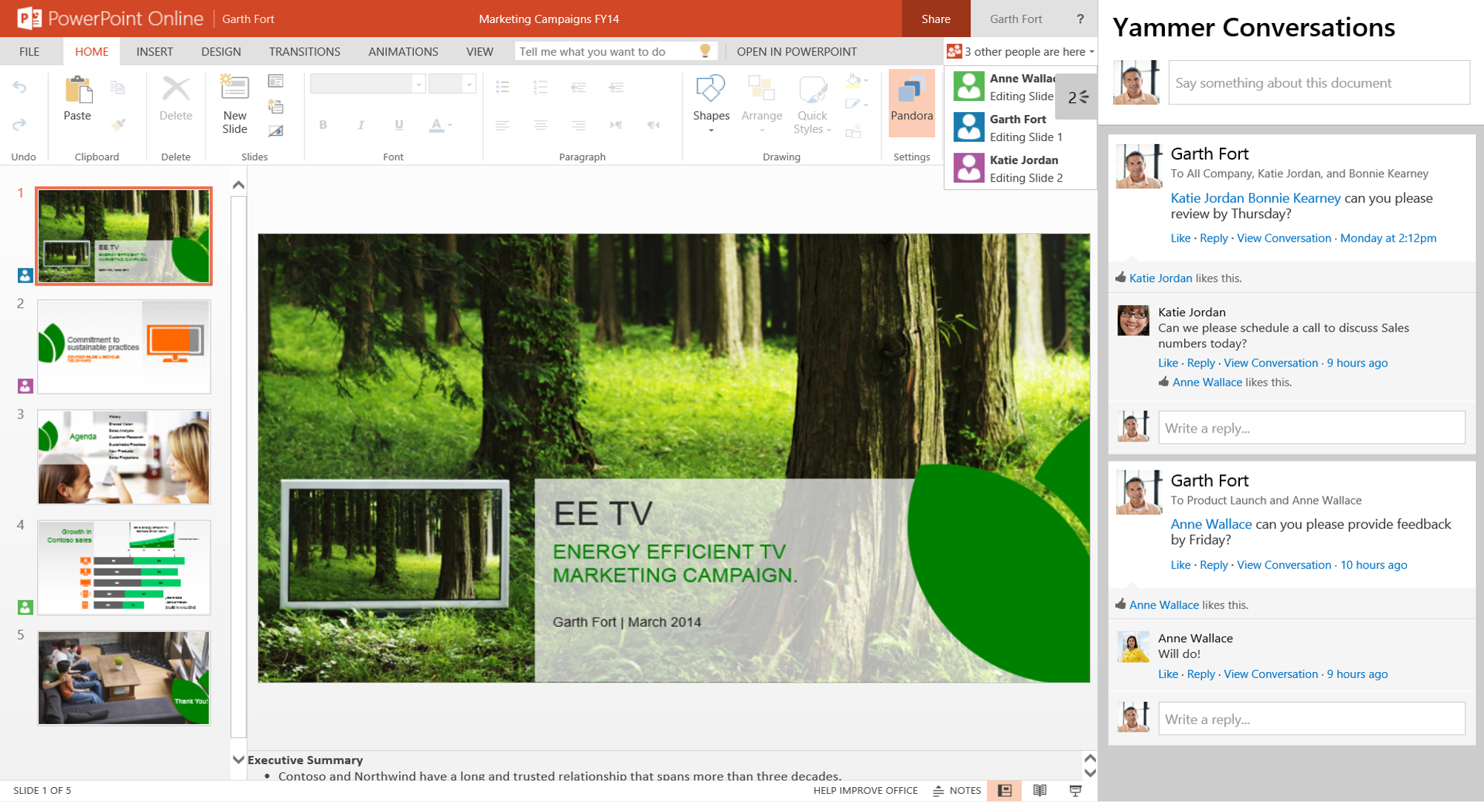
文件與影音與社群協同作業
跨平台的儲存, 同步與分享檔案
一致的使用者介面
行動裝置與觸控支援
企業社群整合
Save files up to 10GB
Secure cloud based video upload, storage and optimized playback
Inline Social experiences across Office makes posting updates, docs, emails easy
Rename and move files without updating links
Create, manage, and subscribe to various channels
Collaborate on Office documents in real time
Capture, share, and discover videos from any device
SharePoint-based file storage provides a single place to manage your content

Slide 23
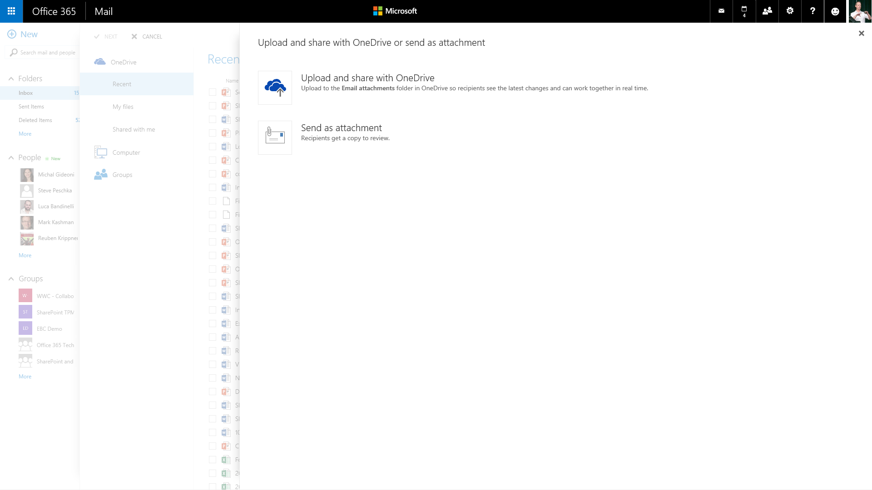
現代化附件方式
e-mail 附件中直接儲存與共享 SharePoint Server 2016 檔案
Directly attach a file from SharePoint or OneDrive
Familiar attachment interface for uploaded document

Slide 24



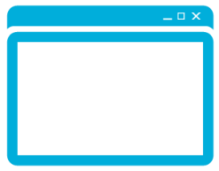
永久性連結
文件 ID 為基礎的連結
修改檔名與搬移也維持相同的連結
Cobalt endpoint for getting file for client
Redirect manager: based on this docID, provide the right way to get a doc
URL with SiteID & DocID to WOPI
…
User clicks docID-based durable URL
GuestAccess.aspx URL for WOPI
Notes:
https://thesharepointfarm.com/2015/08/sharepoint-2016-durable-links/
http://sharepointdailynews.blogspot.tw/2015/08/activate-durable-links-in-sharepoint.html

Slide 25
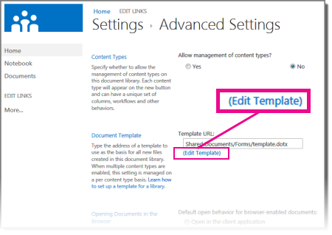
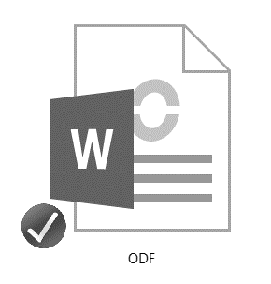
支援 ODF 文件樣版
允許在文件庫中設定 ODF 檔案樣版
新增與儲存 ODF 檔案
Notes:
內建支援 ODF (Open Document Format)

Slide 26
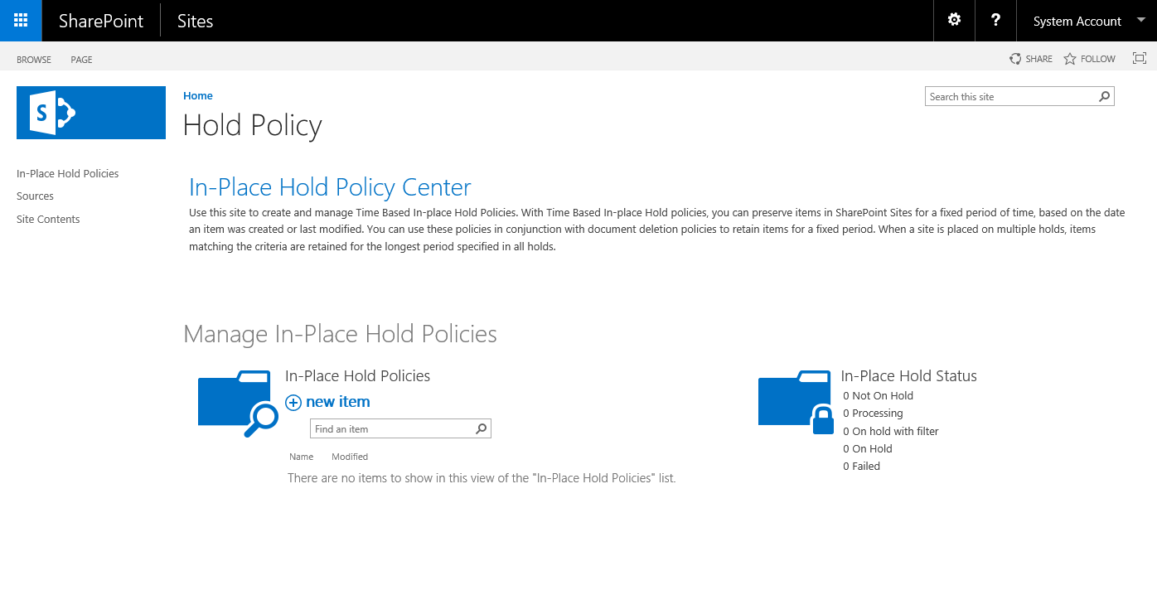
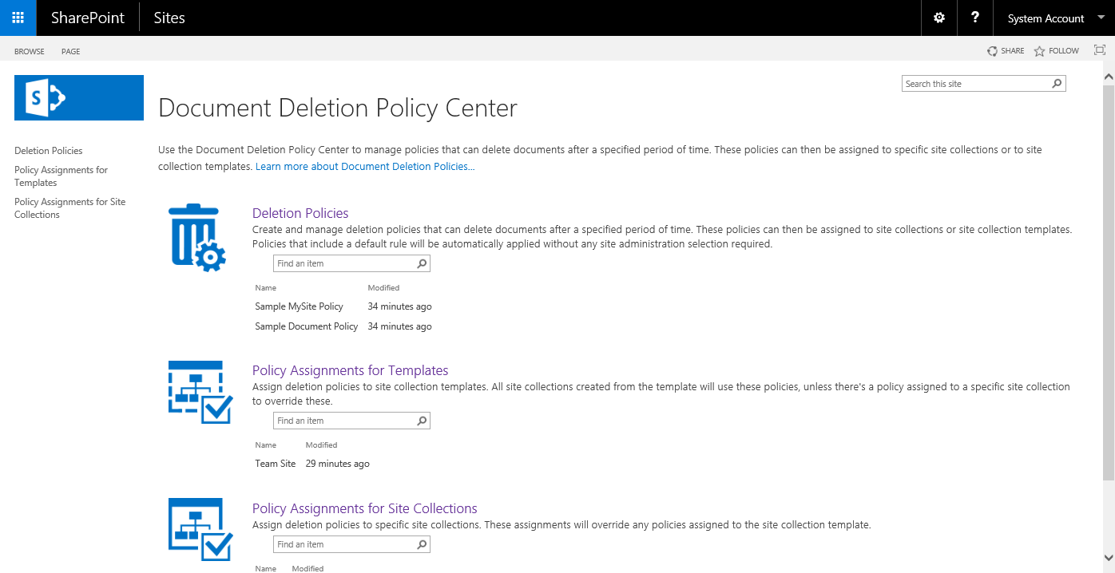
規範
文件刪除原則中心
就地保留原則中心
Notes:
規範中心功能
目前 SharePoint Server 2016 新增兩個網站樣版
文件刪除原則中心 - 可以為網站與網站集合設定文件保留予刪除的原則
就地保留原則中心 – 可以設定規則針對重要文件內容作保留, 防止資料丟失
配合原有的 eDiscovery 網站樣版
可以做到企業文件規範的需求

Slide 27
其他新功能
強化 Sharing 功能
圖像與影音預覽
WOPI 支援 (改檔名, 刪除檔案)
網頁追蹤 (Site Pinning)
網頁目錄檢視 (Site Folder)
文件庫無障礙支援 (文件庫導盲磚)
ReFS 支援
Notes:
Sharing
The following list shows the sharing improvements that are available for SharePoint Server 2016 IT Preview:
Create and Share folder
Sharing Hint
See who the folder is shared with when viewing a folder
Members can share
Improved invitation mail
One-click email to approve or deny a request for access
Alt + N - New
Alt + E - Edit
Alt + U - Upload
Alt + M - Manage
Alt + S - Share
Alt + Y - Synchronization

Slide 28
現階段 Preview 的過時功能
Standalone 安裝模式
ForeFront Identity Manager client (FIM)
Tags and Notes
Excel Services 設定功能
Trusted data providers
Trusted file locations
Trusted data connection libraries
Unattended service account
Excel Services Windows PowerShell cmdlets
BI 功能 (Power Pivot and Power View add-ins for SharePoint 2013 現階段不相容)
Stsadm
註: 詳細請參考: https://technet.microsoft.com/en-us/library/mt346112(v=office.16).aspx
Notes:
https://technet.microsoft.com/en-us/library/mt346112(v=office.16).aspx
The following Excel Services functionality has been deprecated:
Trusted data providers
Trusted file locations
Trusted data connection libraries
Unattended service account
Excel Services Windows PowerShell cmdlets
Opening of Excel workbooks from SharePoint Central Administration site
The following Excel Services functionality requires Excel Online in Office Online Server Preview:
Viewing and editing Excel workbooks in a browser (with or without the Data Model)
Excel Web Access web part for SharePoint
ODC file support (no longer requires Data Connection Librariees)
Programmability features such as JavaScript OM, User Defined Function Assemblies, SOAP and REST protocol support
https://social.technet.microsoft.com/Forums/en-US/de208bfa-1fbe-4f2c-bb76-c94e844f5d5d/is-excel-services-for-sharepoint-2016-deprecated?forum=SP2016

Slide 29
安裝部署與升級
安裝
部署
升級

Slide 30
硬體需求
支援 Stretched Farm (2 datacenters)
Network Latency < 1ms (99.9% in 10 mins)
1 gigabit per second
 | 處理器 | 記憶體 | 磁碟空間
Single Server | X64 4 Cores | 16-24G | 80G (System) 100G(Secondary)
Server Farm | X64 4 Cores | 12-16G | 80G (System) 100G(Secondary)
Notes:
Some enterprises have datacenters that are in close proximity to one another and connected by high-bandwidth fiber optic links. In this environment, you can configure the two datacenters as a single farm. This distributed farm topology is called a stretched farm. Stretched farms for SharePoint Server 2016 IT Preview are supported.
For a stretched farm architecture to work as a supported high-availability solution, the following prerequisites must be met:
There is a highly consistent intra-farm latency of <1 ms one way, 99.9% of the time over a period of ten minutes. (Intra-farm latency is commonly defined as the latency between the front-end web servers and the database servers.)
The bandwidth speed must be at least 1 gigabit per second.
To provide fault tolerance in a stretched farm, use the standard best practice guidance to configure redundant service applications and databases

Slide 31
先決條件
Windows Server 2012 R2
SQL Server 2014 SP1 X64
Windows Server 2016 Preview
SQL Server 2016 Preview
Windows Management Framework 3.0
Application Server Role
Web Server (IIS) Role
Microsoft .NET Framework 4.5.2
Update for the .NET Framework 4 (KB2898850)
Microsoft SQL Server 2012 Native Client
Microsoft Identity Extensions
Microsoft Sync Framework Runtime v1.0 SP1 (x64)
Windows Server AppFabric 1.1
Windows Identity Foundation v1.1
Microsoft Information Protection and Control Client
Microsoft WCF Data Services
Provides support for Windows PowerShell 3.0
Provides support for Windows PowerShell 3.0
.NET Framework 4.5.2
.NET Framework 4.0
Provides in memory distributed caching
Provides in memory distributed caching
Provides support for information protection
Provides support for information protection
Enables the creation & consumption of OData services

Slide 32
瀏覽器支援
瀏覽器 | 支援
Microsoft Edge
IE 11
IE 10
IE 9, 8, 7, 6
Google Chrome (最新版本)
Mozilla Firefox (最新版及次一版本)
Apple Safari (最新版本)
V
V
V
X
V
V
V

Slide 33
行動裝置瀏覽器支援
Internet Explorer and Microsoft Edge on Windows Phone 8.1 or later
Latest version of Chrome on Android 4.4 or later
Latest versions of Safari and Chrome on iOS 8 or later

Slide 34
部署情境
 | SP 2013 | SP 2016
Workgroup
Domain Controller
Client OS
Dynamic Memory
Windows Web Server
X
X
Dev
Dev
X
X
X
X
X
X

Slide 35
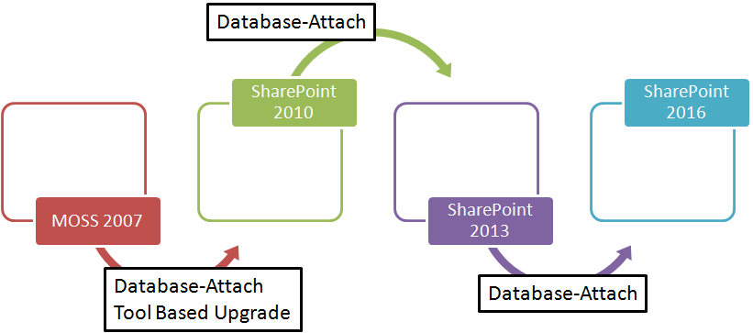
V2V 升級
SPF 2013 -> SPS 2016
SPS 2013 -> SPS 2016
資料庫掛載 (僅 15 模式的網站可以升級)
升級前嘗試資料庫掃描
http://www.c-sharpcorner.com/UploadFile/d2ee01/upgrading-to-sharepoint-2016/

Slide 36
資料庫掛載升級 Demo
Notes:
RESTORE DATABASE SP13_WSS_Content_80_ToSP16
FROM DISK = N'L:\Program Files\Microsoft SQL Server\MSSQL12.MSSQLSERVER\MSSQL\Backup\SP13_WSS_Content_80.bak'
WITH RECOVERY,
MOVE 'SP13_WSS_Content_80' TO 'M:\Program Files\Microsoft SQL Server\MSSQL12.MSSQLSERVER\MSSQL\DATA\SP13_WSS_Content_80_ToSP16.mdf',
MOVE 'SP13_WSS_Content_80_Log' TO 'L:\Program Files\Microsoft SQL Server\MSSQL12.MSSQLSERVER\MSSQL\Data\SP13_WSS_Content_80_ToSP16_log.ldf'
GO
Test-SPContentDatabase -Name SP13_WSS_Content_80_ToSP16 -WebApplication http://asabulusp16:1999
Mount-SPContentDatabase -Name SP13_WSS_Content_80_ToSP16 -WebApplication http://asabulusp16:1999

Slide 37
常見問題
SP 2016 會是最後 On-Prem 版本嗎?
SP 2016 的版本? 會有 Foundation 版本嗎?
SP 2016 支援的語系?
SP 2016 UI 會有改變嗎?
Form 和 Workflow 策略如何?
AppFabric 支援生命週期至 2017/4/2 會影響 Distributed Cache 的支援嗎?
SP 2016 會有 Groups 的功能嗎?
SP 2016 對 Developers 有哪些新功能?
Notes:
5分鐘
目前沒有計畫
Standard 和 Enterprise, 現階段不會有 Foundation 一起 Shipped,
https://technet.microsoft.com/en-us/library/ff463597.aspx
基於 O365, 網頁會持續進行重新設計, 效能改進
InfoPath (2016 client 不再 shipped, InfoPath 2013 仍可繼續使用, Workflow Manager 和 WWF 仍可以使用 SPD 2013, 但不會有 SPD 2016)
Distributed Cache 在 SP 仍會依照 SP 的技術支援週期
Groups 是專屬的 Office 365 的功能, SP 不會有
支持 Office 365 API 的開發

Slide 38
SharePoint Server 2016 新功能總表
Modern Document Experiences New Doc Lib UX (qcb, no ribbon) Multi-file upload, better drag/drop redesigned menus (inc. right-click) Modern Attachments (w/ EX) OneDrive for Business Shared With Me Shared Folders * (assumes sync client support) Site Folders “Face pile” Infinite Scrolling First Run Experience Recycle Bin Sharing Experiences Members Can Share Sharing Emails New Sharing Dialog Access Requests Redesign Additive permissions Mobile Web Experiences OneDrive for Business Team Sites Sites Hub Other Experience Improvements New profile page (immersive) New sites hub (site thumbnails) | Information Protection DLP Encryption Archiving eDiscovery Auditing Performance and Reliability Faster pages throughout SP Fast site creation Upload/Downloading chunking for higher throughput and reliability Sync reliability Manageability In place upgrade SAML parity with Windows MinRole Windows and Office Ecosystem Version API for Universal Apps Runs on Threshold Server Access & InfoPath Open in Excel Cascading Combo Boxes Developer Office 365 API’s Common consent Subscription Apps | Document Management Large File Support (10GB) Durable URLs Large Lists (>5000) Removing character restrictions WAC New app experiences File / new; rename; sharing; MRU Search Scale Improvements 2x (to 500m docs) Simplified Deployment/Admin Project Resource Engagements Getting Started Experience Simplified IT Administration Performance/Scale Improvements Data Integrity Hybrid Configurations Search (cloud indexing) Yammer OneDrive for Business Delve Sites / Groups / Cross-org Collaboration Sites Video Portal Hybrid Apps / Alchemy

Slide 39
